Slide 1
Air Hockey Computer Opponent
ECE532 – Group 3
Richard Lin Jashva Rafique
Emil Karimov Prabnoor Kainth

Slide 2
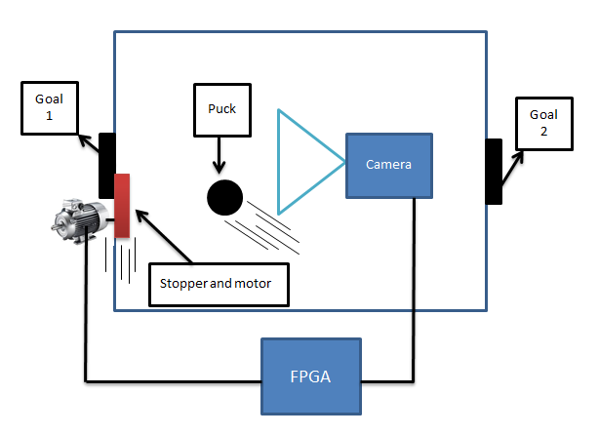
Project Goal

Slide 3
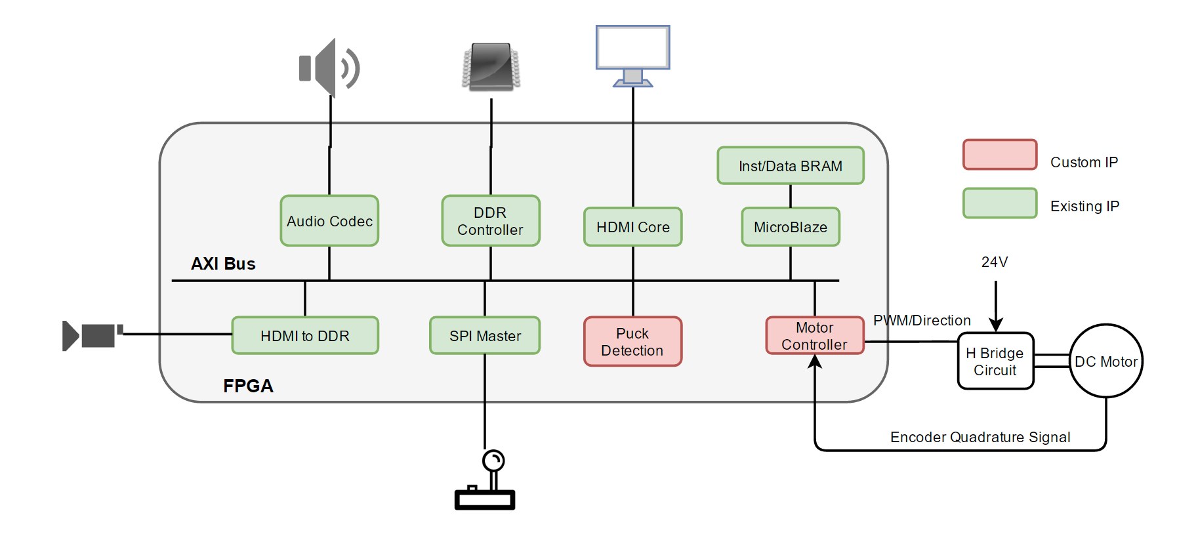
Project Block Diagram (Simplified)

Slide 4
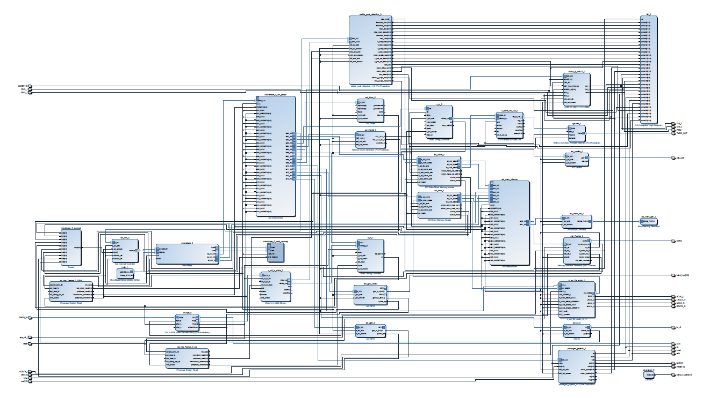
Project Block Diagram

Slide 5
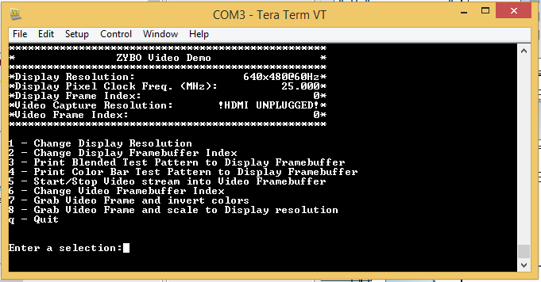
HDMI Demo Project (Digilent)
Video In: TMDS → RGB → AXI4 Stream → VDMA
Video Out: VDMA → AXI4 Stream → DVI → TDMS

Slide 6
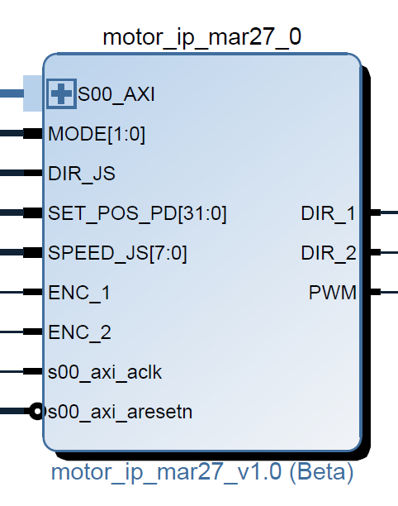
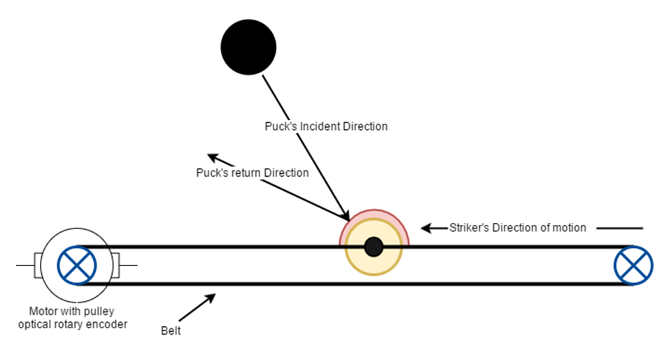
Motor Actuation Block (Custom)

Slide 7
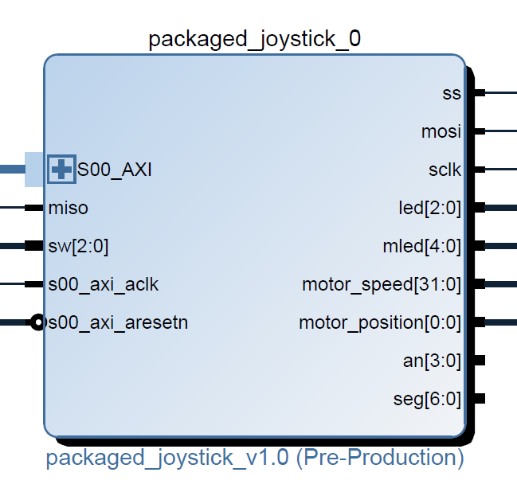
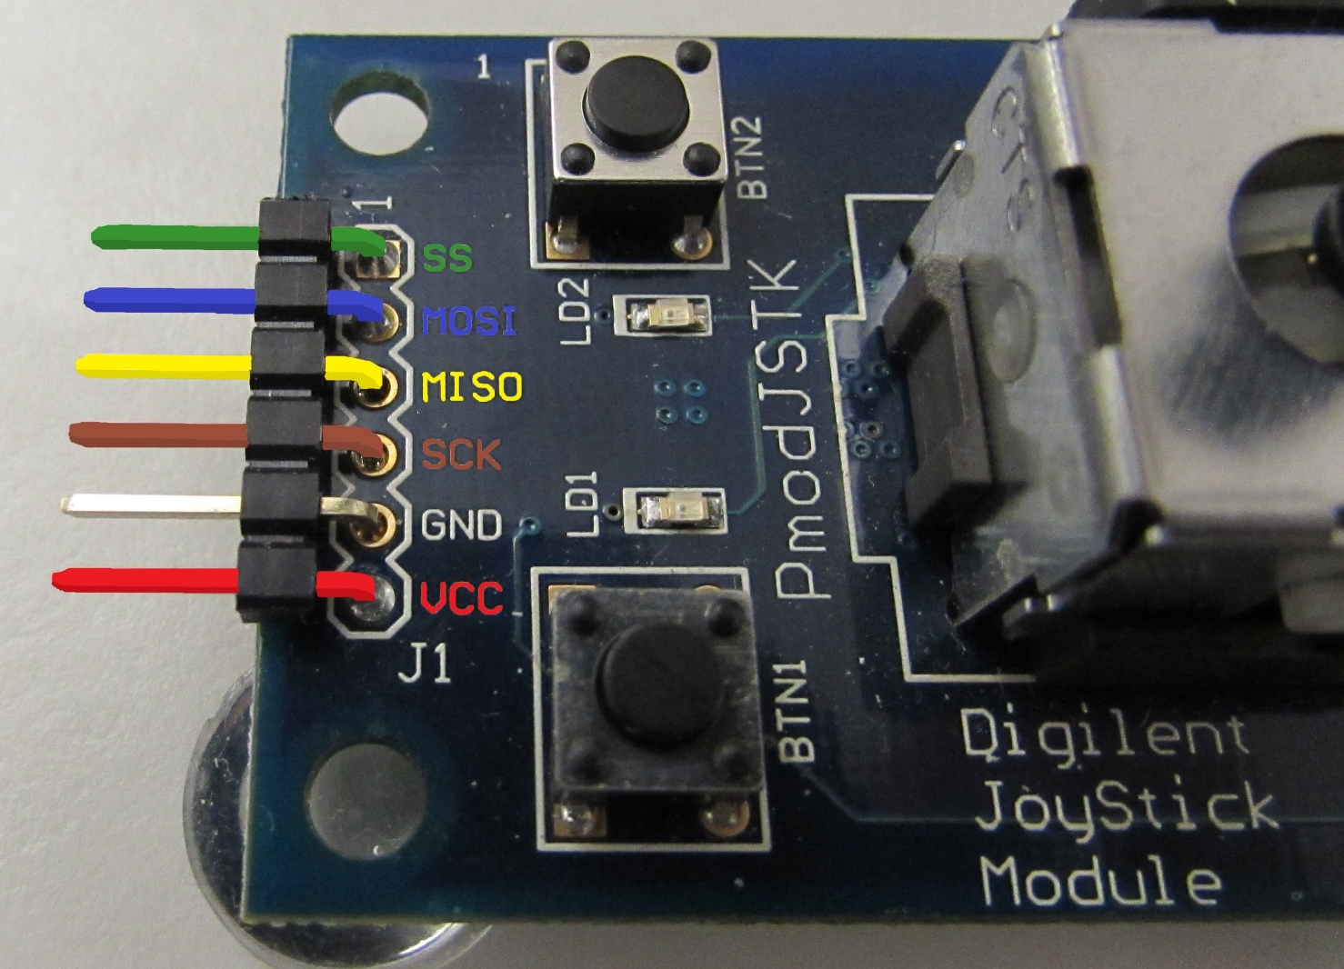
Joystick Demo (Digilent)

Slide 8
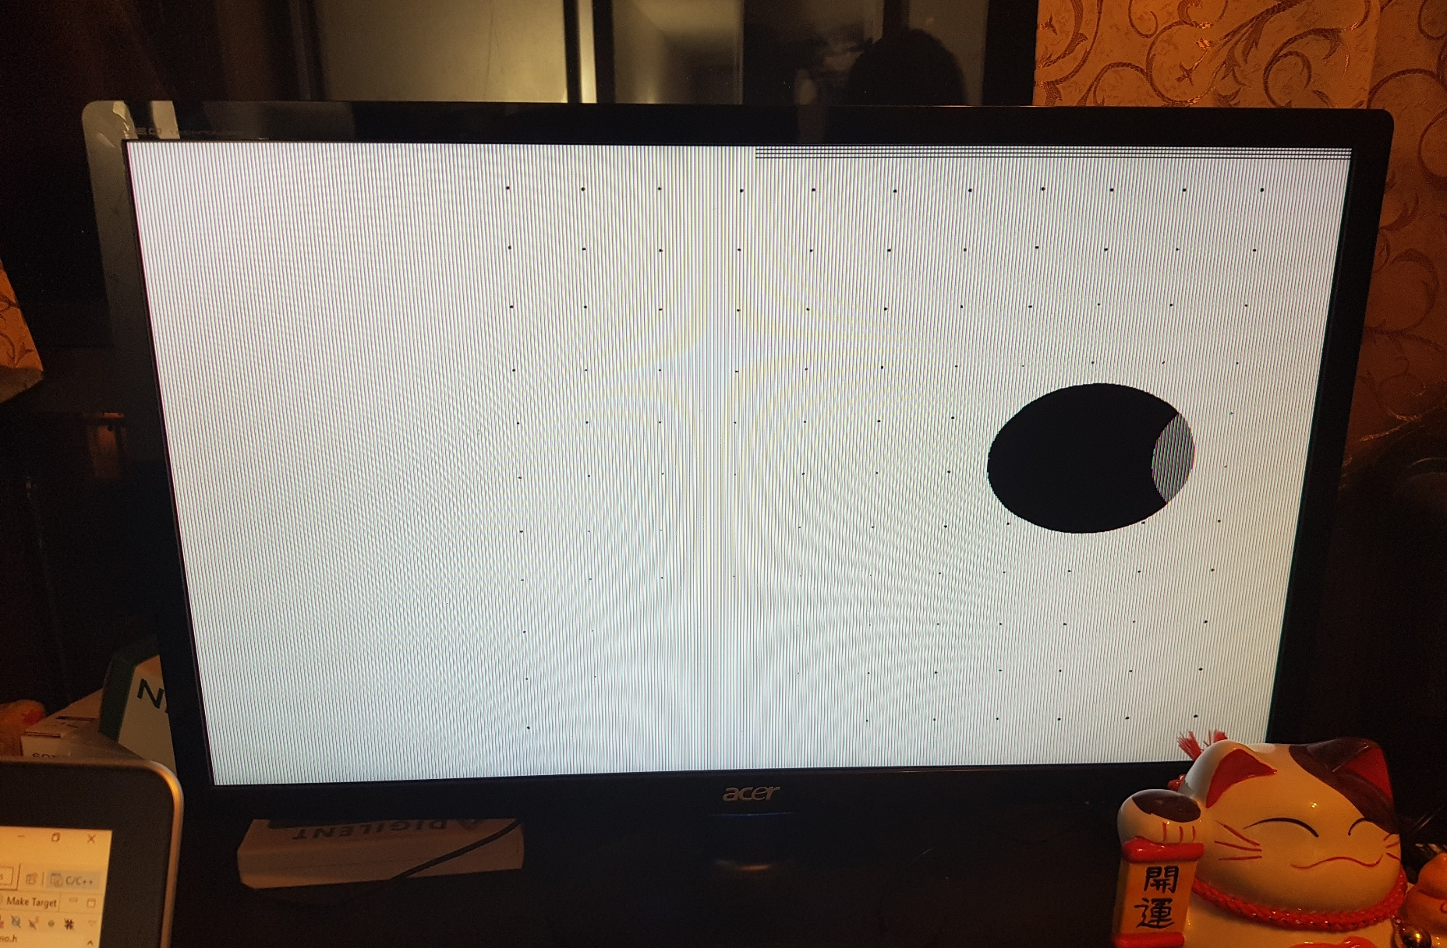
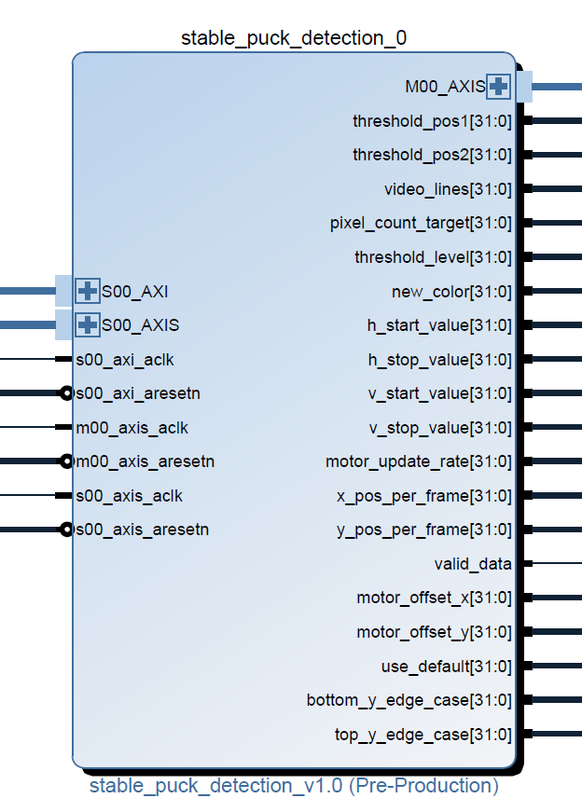
Puck Detection & Trajectory Block (Custom)

Slide 9
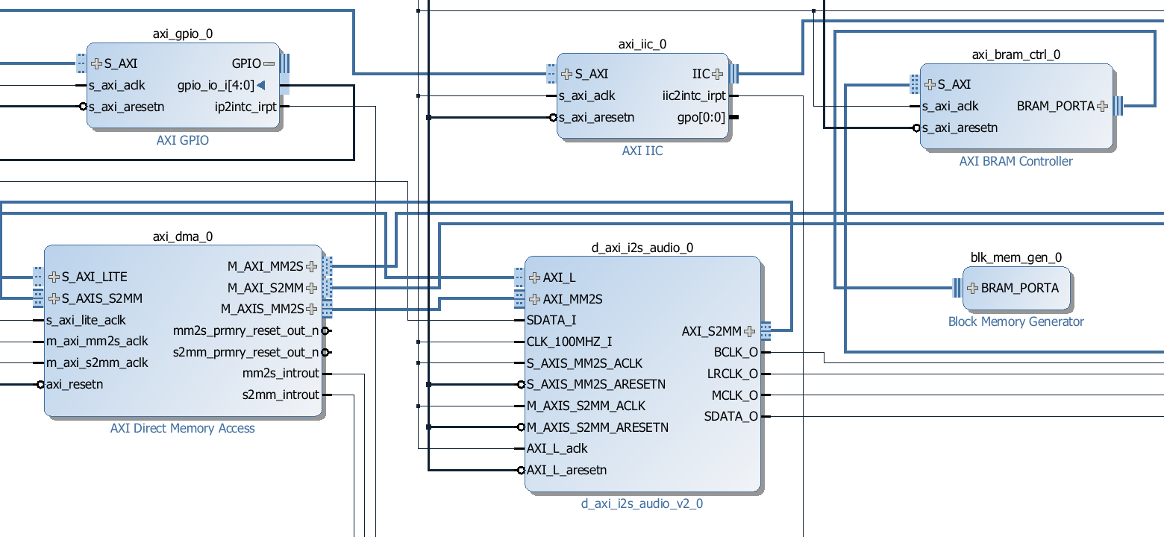
DMA Audio Demo Project (Digilent)

Slide 10
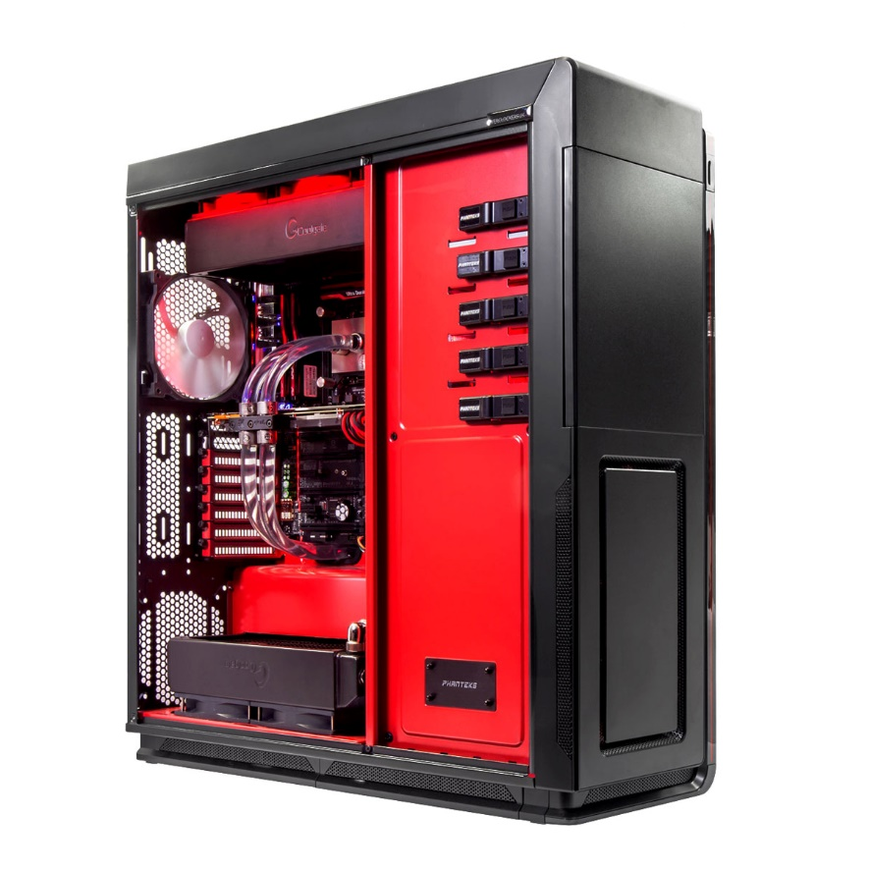
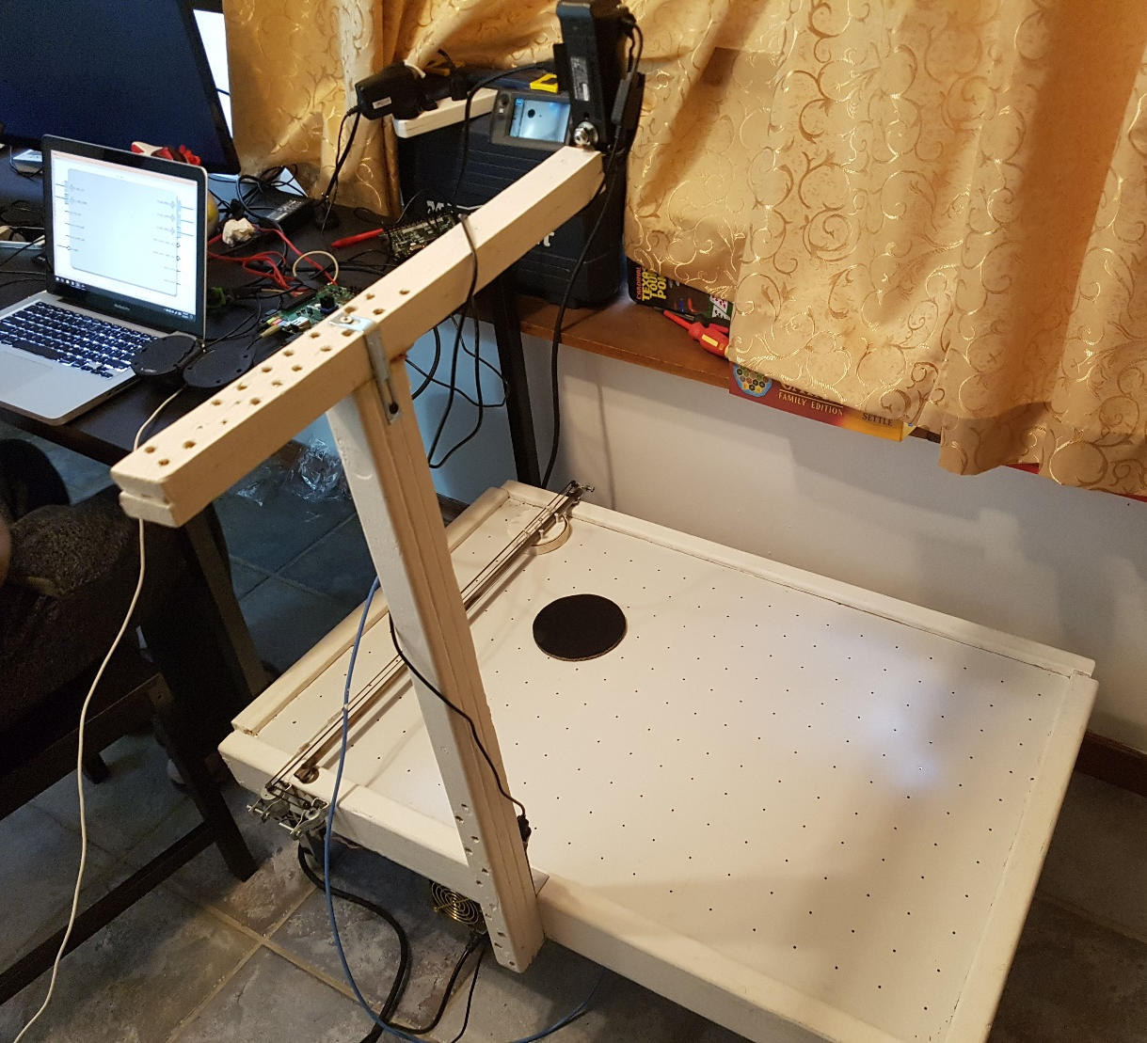
Design Process
Integrated Logic Analyzer
&
Simulations
Offload Synthesis & Implementation

